Slide 1

data science project

Slide 2
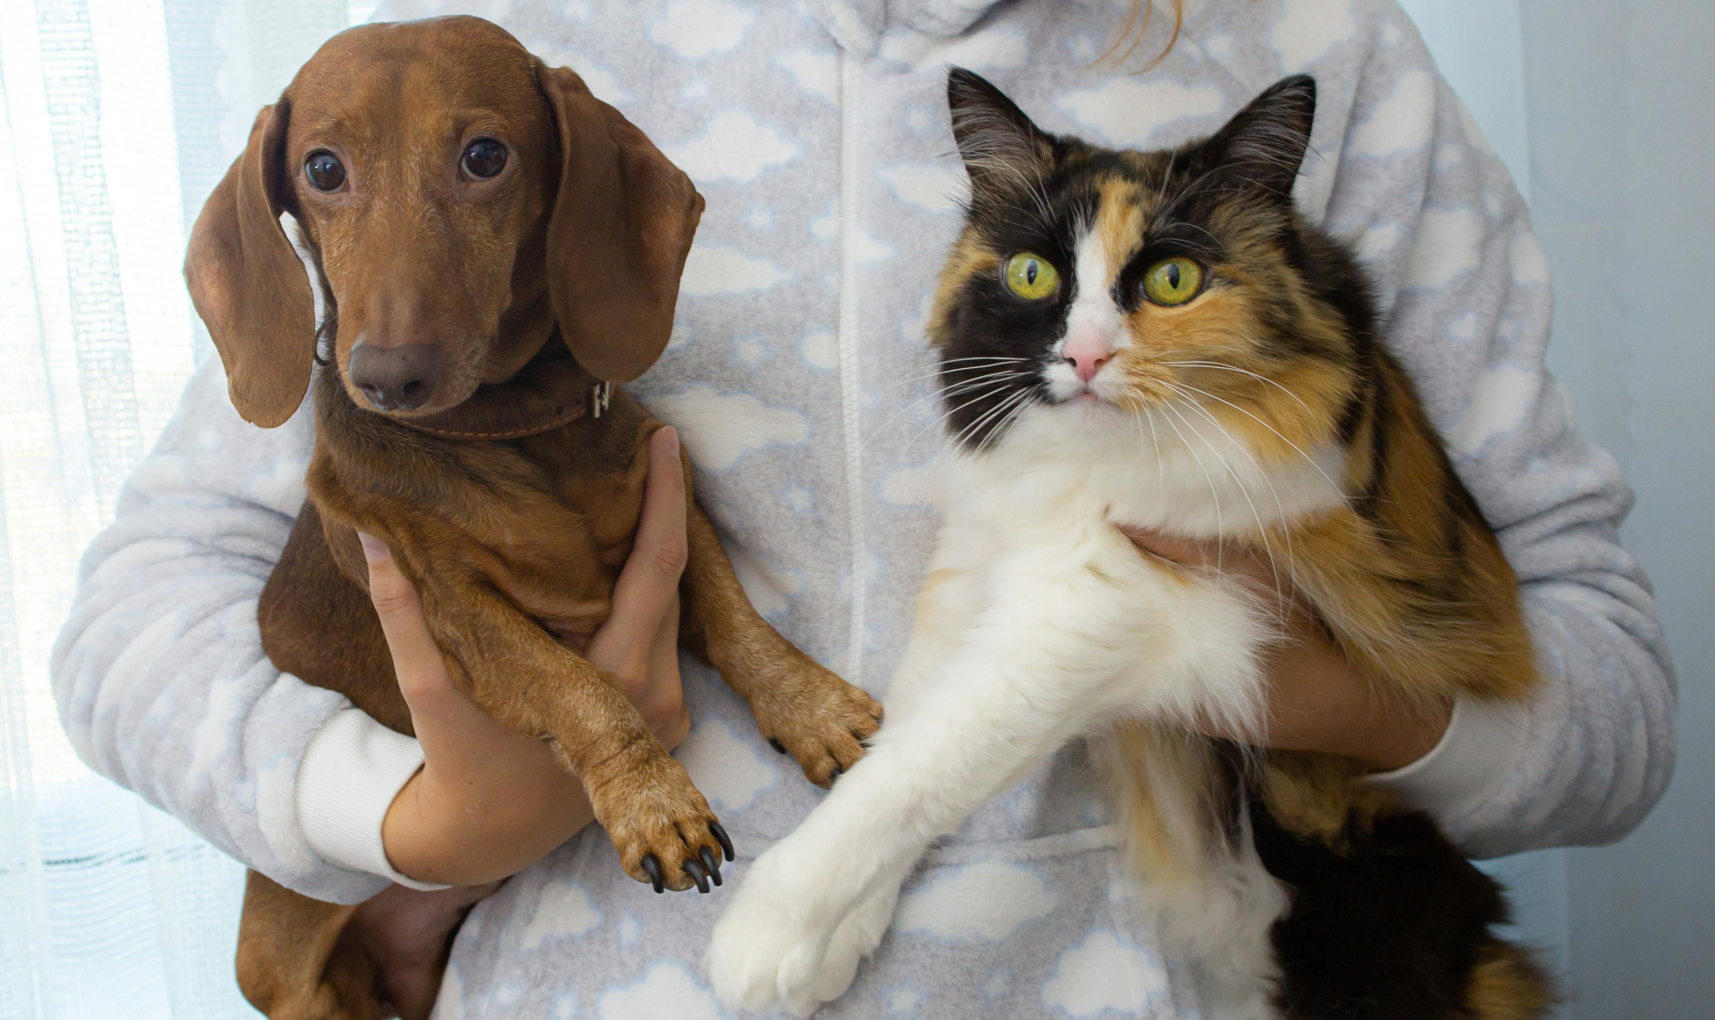
Introduction

Slide 3


Problem
The problem of dog and cat classification involves building a model that can accurately distinguish between images of dogs and cats , given an image as input, the model should predict whether an image is for a dog or a cat..
IDEA
One approach to solve the dog and cat classification problem is by using Convolutional Neural Networks (CNNs). CNNs are well-suited for image classification tasks as they can automatically learn relevant features from the images.

Slide 4

dataset

Slide 5
Dataset description
25000 images of dogs and cats
https://www.kaggle.com/competitions/dogs-vs-cats/data
Dataset preprocessing
we split the dataset into 20% for testing and 80% for training
spotted some noise images so we eliminated them
rescaled the rest of pictures

Slide 6

MODELS

Slide 7
implemented model :
in general we choose the Convolutional neural network as it is most commonly applied to analyze visual imagery and good at image classification and we practiced and applied some regularization techniques for to improve the model performance like data dropout and data augmentation .
pretrained model :
we used mobilenet_v2 , so we practiced some of the enhancement that could be done to improve the model performance like data augmentation and add three layers on it 2dense, dropout layers

Slide 8



RESULTS

Slide 9
Results
Implemented model :
Accuracy : 85.5%
AUC : 0.9306
Precision : 0.853
Recall : 0.853
Confusion matrix
Actual values
 | positive | negative
positive | 4256 | 736
negative | 736 | 4256
Predicted values

Slide 10
Results
Pretrained model :
Accuracy : 98.7%
AUC : 0.9561
Precision : 0.9716
Recall : 0.96
Confusion matrix
Actual values
 | positive | negative
positive | 4795 | 4744
negative | 248 | 197
Predicted values

Slide 11
Conclusion.
Comparing a model built from scratch to a pretrained one shows the inherent advantages of leveraging pretrained models. The scratch-built model, while achieving an 85.5% accuracy, falls short in terms of other metrics like AUC, precision, and recall.
On the other hand, the pretrained model performs exceptionally well across the board, with a significantly higher accuracy of 98.7%, a superior AUC of 0.9561, and impressive precision and recall scores

